Slide 1
Bootstrap:2
#Bootstrap2
Building on a foundation
Notes:
Each of you brings something special. Experience with BS:1 in Racket. Experience with BS:2 in Racket. Experience with Python, C++, Java. No bias at all wrt/Bootstrap.
BS teachers - most of you are math teachers, who've mastered the BS pedagogy. You're here to learn content.
CS teachers - you know the content. you're here to learn pedagogy.
If you've seen BS:1, you know just how high a bar we set for ourselves in terms of polish. This isn't quite there yet - we think the foundations are sound.

Slide 2
Bridging to CS
K-12
Little CS engagement Weak Algebra
College/AP/Industry
C-like syntax
Programming, not hacking

Slide 3
Bridging to CS
K-12
Engaged students
Bootstrap:1
“What’s next?”
College/AP/Industry
C-like syntax
Programming, not hacking
“Who will teach these classes?
Notes:
We COULD teach all the high-level concepts in Racket. It is, after all, a full-blown programming language!
But we still run into the issue of transfer. Even if kid learn about objects, classes, recursion, etc in Racket...they have to cross the syntax barrier eventually.
EVERYONE is in this boat. Going from Scratch->Python, Blockly->Python, etc. Everyoe is freaking out!

Slide 4


It was never about the language
Low Floor Circles of Evaluation Algebraic behavior Great pedagogy
Low ceiling “Weird” syntax Limited bridge to other languages
High Ceiling Mainstream syntax Popular
High Floor Not algebraic! Limited bridge from other languages
High Ceiling
Mainstream syntax
Algebraic behavior
Great pedagogy
No Circles of Evaluation
New Syntax
Notes:
Python is the 4th mos tpopular language in the world!

Slide 5
Goals for this workshop
Introduce you to Pyret
Demonstrate Bootstrap:1 pedagogy applied to higher level computer science
Build sophisticated programs
Talk to other teachers
Get your feedback
Notes:
We’re out to get the foundations right. Everything else is just elbow grease.

Slide 6
Challenges for this workshop
Radically diverse group of teachers!
Switching between “teacher” and “facilitator” roles
The curriculum assumes BS:1, but not everyone here has seen BS:1
We’ve never done it before!
Notes:
We’re out to get the foundations right. Everything else is just elbow grease.

Slide 7
Unit 1
Notes:
Two tabs: CPO bootstrapworld BS2,

Slide 8
Everything you learned in BS:1
code.pyret.org
www.BootstrapWorld.org/preview/materials/fall2015
Open the Review file
Introducing CPO…
Infix notation
Image module

Slide 9
Operations
Need PD slide talking about operators, don’t use + as first contract example: “We’re graduating from circles of evaluation"

Slide 10
Contracts
<name> : <domain> → <range>
# + : Number Number → Number
# - : Number Number → Number
# * : Number Number → Number
# / : Number Number → Number
# num-sqrt : Number → Number
# num-sqr : Number → Number

Slide 11
Contracts
circle(75, “solid”, “red”)
rectangle(20, 30, “outline”, “pink”)
ellipse(85, 100, “solid”, “green”)
text(“Hello world!”, 50, “blue”)

Slide 12
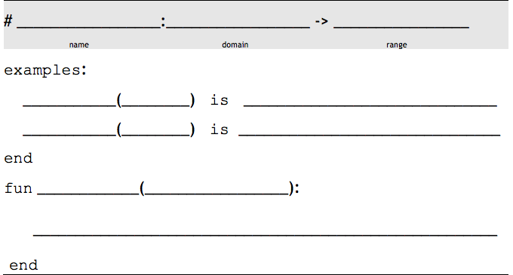
The Design Recipe
triple
Number
Number
n
triple
6
6 * 3
triple
13
13 * 3
triple
n
n * 3

Slide 13
The Design Recipe
gt
Number
Image
size
gt
7
triangle(7, “solid”, “green”)
gt
22
triangle(22, “solid”, “green”)
gt
size
triangle(size, “solid”, “green”)

Slide 14
Unit 2

Slide 15
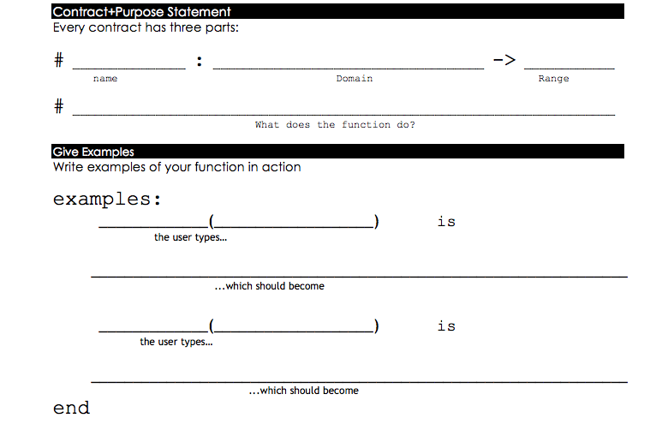
double-radius
Number String
Image
Consumes a radius and color, produces an outlined circle of the given color whose radius is twice the given number
color
double-radius
30, “red”
radius
circle( 30 * 2, “outline”, “red”)
double-radius
7, “purple”
circle( 7 * 2, “outline”, “purple”)

Slide 16
Parachute Jumper
What datatype should my range be?
Number? String? Image? Boolean?
Introducing Coords…
# coord : Number Number → Coord
Coords are just another value…

Slide 17
fall
Number Number
Coord
Given an x and y, produces a Coord with x + 5 and y - 5
y
fall
33, 70
x
coord(33 + 5, 70 – 5)
fall
8, 20
coord(8 + 5, 20 – 5)

Slide 18
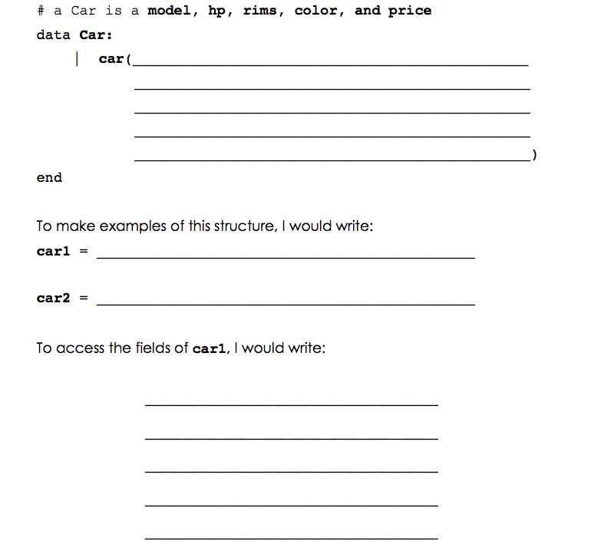
model :: String,
hp :: Number,
rims :: Number,
color :: String,
price :: Number
car(“M5”, 480, 28, “black”, 50000)
car(“Prius”, 160, 18, “blue”, 20000)
car1.model
car1.hp
car1.rims
car1.color
car1.price
Notes:
NEW SYNTAX!!!
Data block, listing the name of the field and the type of the field, separated by two colons

Slide 19
Unit 3

Slide 20
Data Structures
Open a new Pyret file
Write the data definition for Party
Define a new structure of your own!

Slide 21
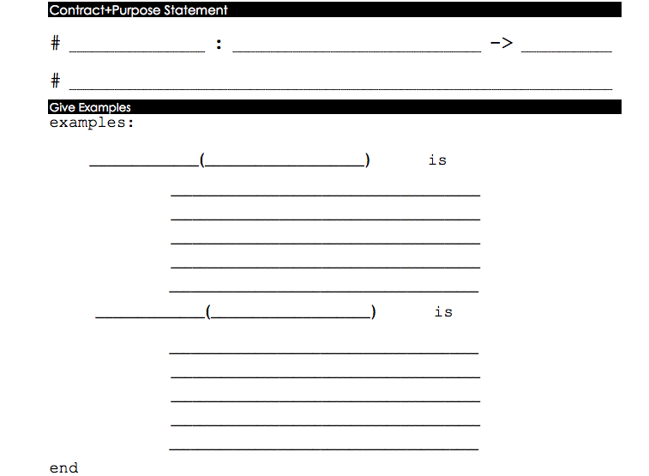
paint-job
Car String
Car
Consumes a Car and color, produces a Car painted the given color
paint-job
car1, “purple”
color
car(
car1.model,
car1.hp,
car1.rims,
a-car
“purple”,
car1.price)
paint-job
car2, “green”
car(
car2.model,
car2.hp,
car2.rims,
“green”,
car2.price)

Slide 22
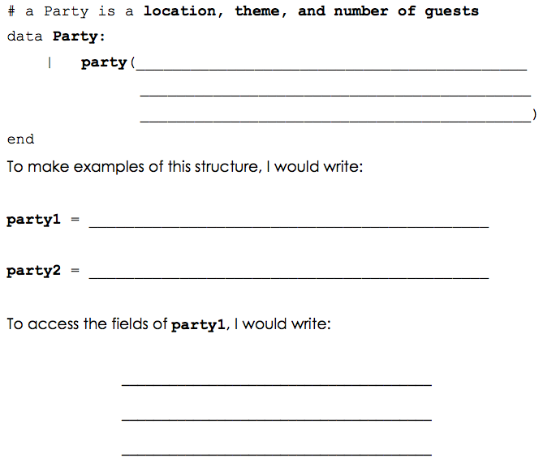
location :: String,
theme :: String,
guests :: Number
party(“Startup Institute”, “Bootstrap”, 16)
party(“My house”, “Birthday”, 200)
party1.location
party1.theme
party1.guests

Slide 23
Unit 4

Slide 24
Steps to Make a Game
SLIDE: Steps to make a game- outline for the progress of a game throughout the workshop so teachers know the general progression

Slide 25
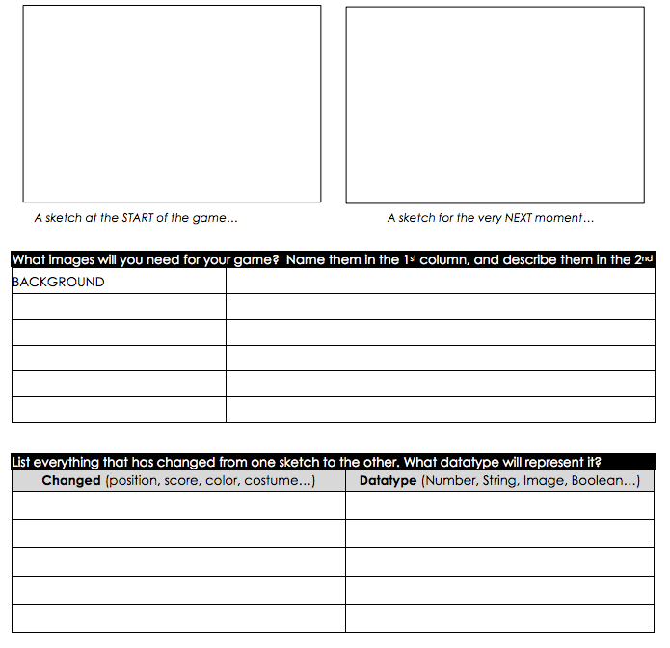
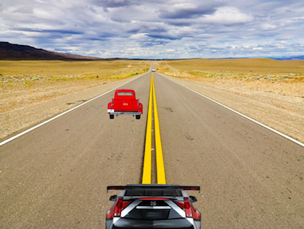
Desert road

Slide 26
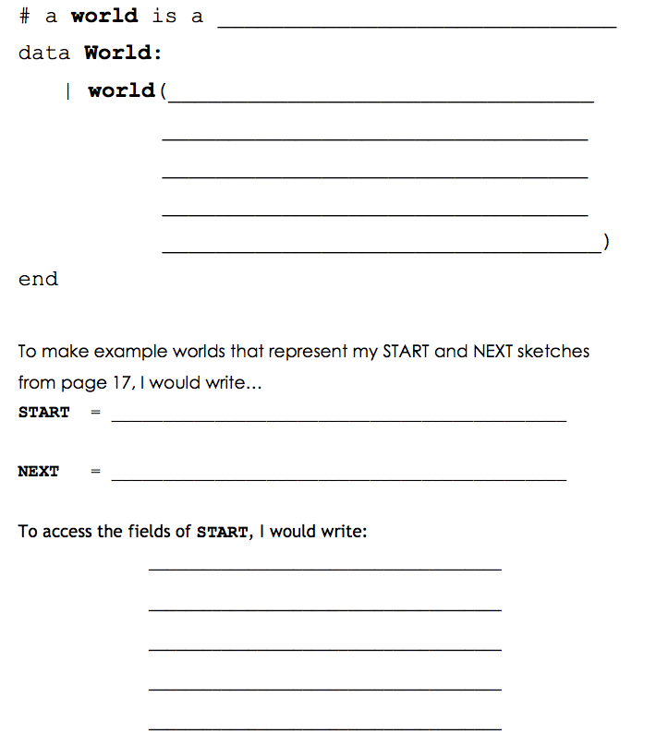

Slide 27
Unit 5

Slide 28
Your Game
Open the BS:2 Blank Game template
Using Pages 17 and 18, define your World structure and two example Worlds (try START and NEXT!)
Take 10 minutes to find game images and use image-url to put them in the GRAPHICS section

Slide 29
draw-world: page 20
update-world: page 21

Slide 30
Unit 6

Slide 31
Luigi’s Pizza
What does cost(“cheese”) evaluate to?
What will happen for cost(“onion”)?
What is this function doing?
Add “mushroom” to the menu, for $11.99
Change the code to add your favorite topping!
Change the code to charge customers $1000.00 for anything not on the menu

Slide 32
Keypress: Ninja Cat
Open the Ninja World 3 file
Can you make Ninja Cat move down as well?
Can you make Ninja Cat move left and right?
Turn to page 22: What keys control your game?

Slide 33
Keypress: Your Game
A new event-handler!
on-key(keypress)
Challenges:
Warping
Boundary detection
Wrapping
Hiding

Slide 34
Unit 7

Slide 35
Asking the World
Strong-password
# > : Number Number → Boolean
# < : Number Number → Boolean

Slide 36
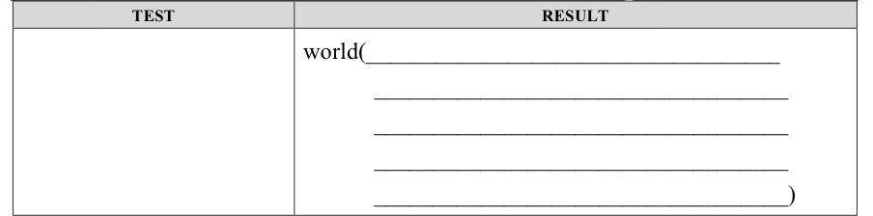
Helper functions
is-off-right(w.dogX)
0, w.coinX - 5, w.catX,
w.catY

Slide 37
Unit 8

Slide 38
Collision Detection

Slide 39


Thank You
Facebook.com/BootstrapWorld
@Bootstrapworld

